Slide 1


Artificial
Intelligence
Based Voice Assistant
CSE 2039
REVIEW 1

Slide 2

The Team
HARISH KUMAR K
SOURASISH PAL
20BRS1231
20BRS1216
MADHAV SRIVALSAN
SRUTHI R
20BRS1202
20BRS1271

Slide 3

Objective
Existing System
01
03
Scope
Methodology & Block Diagram
02
04
Brief Summary of the Project
What is new in our project other than the existing ones
Purpose of the Project
Implementation and Working

Slide 4
01
Objective
Voice control is a rapidly expanding function that is altering people's lifestyles.
Smartphones and laptops are frequently equipped with voice assistants.
Al-based voice assistants are operating systems that can identify and reply to human speech using several voices.
This voice assistant will collect audio from the microphone, convert it to machine-readable format, and decide what the user needs based on the input and algorithms.
The text will be transformed into an audio file in English, which will then be played using the Python play sound package.
The voice assistant uses natural language processing and speech recognition

Slide 5
02
Scope
With the developing technology in voice assistants improving in differentiating in voices, we need to also need to address the complexity of of developing the assistants so that they are capable to suit any specific type of brand.
There is also a need of focus on comfort on the user experience as growing technology increasing the complexity of the device.
The use of voice assistants is integrated into our everyday lives.
IoT devices are giving voice assistant devices more utility by integrating them to thermostats and smart speakers.
The integration of IoT and virtual assistants can enhance the developing technology rapidly and efficiently.

Slide 6
The application is able to recognize the voice from the user end without internet connection. The verbal commands are converted to text and the operations take place.
The application gives updates regarding the date, time, day, weather, humidity, temperature
Speech Recognition
Updates
Search
Making Notes
Greetings & Jokes
The app is able to search YouTube videos, songs, Wikipedia, google for any information in the internet.
The application is able to create, read, write and delete notes.
The virtual assistant will be able to greet and crack jokes.

Slide 7
03
Existing System
Despite the various benefits provided by speech recognition, the system is also plagued with limitations.
By implication the development of speech recognition applications also inherits these limitations.
The proposed system of voice assistant will solve some issues of existing system as well introduce new features for better quality and usage.
Our Voice assistant is used for giving automatic replies and answers to queries of users.
Till date we can find various types of chat bots
Some existing chatbots use pattern recognition techniques of python which lack in the context, Lack of accuracy, and misinterpretations, Time, costs and productivity, User accents
Instead of pattern recognition technique which has been used in previous models, we use Natural Language Processing (NLP) techniques to recognize the text which is context based rather the usual pattern based.

Slide 8

Block Diagram
04

Slide 9
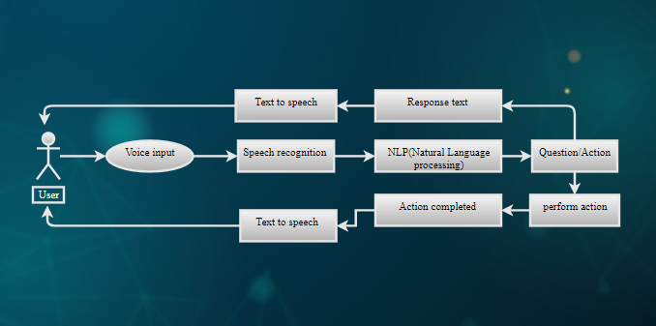

Slide 10
Methodology
Speech Recognition module:
The system uses Google’s online speech recognition system for converting speech input to text.
.
Hi! I am your Personal voice assistant. How can I help?

Slide 11
Python Backend:
The python backend gets the output from the speech recognition module.The output is then sent back to the python backend to give the required output to the user.
Text-to-speech module:
Text-to-Speech (TTS) refers to the ability of computers to read text aloud. A TTS module converts written text to a phonemic representation, then converts the phonemic representation to waveforms that can be output as sound. TTS engines with different languages, dialects and specialized vocabularies are available through third-party publishers.

Slide 12
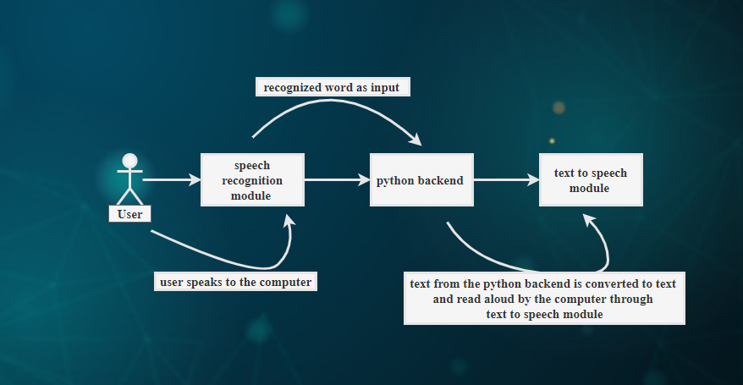

Slide 13
Implementation
Our AI-based Virtual Assistant will be implemented using python libraries, and the google speech recognition API. Python 3.7 or above, Spyder IDE or Visual studio code or pycharm, will be used for the development of the assistant.
Our Voice assistant uses google text-to-speech API to understand all the words spoken by the user, and based on certain conditions that satisfy being a command the voice assistant sends responses to the user.
These commands are then go through Speech Recognition and convert them to a machine-readable format

Slide 14
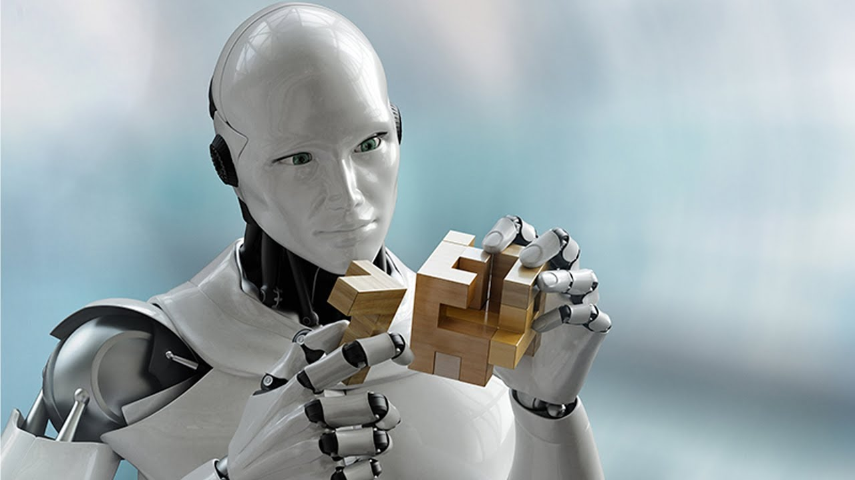
“The coming era of Artificial Intelligence will not be the era of war, but be the era of deep compassion, non-violence, and love.”
Amit Ray, Pioneer of Compassionate AI Movement.
Thank
You!

